Slide 1

Textbook Adoptions and Sales
Andrew T. Arroyo, Office of the Provost
Hillary Miller, VCU Libraries
Bernard Hamm, Registrar
September 3, 2019

Slide 2
Policy: Textbook Adoptions and Sales
Substantial revision: Condenses two existing textbook policies into one policy for simplicity and clarity
Introduces new policy specifics and procedures
  Satisfies federal and state requirements (e.g., VA code § 23.1-1308)
  Responds to emerging issues affecting faculty and students

Slide 3
Significant new legal requirement
Public institutions of higher education must “identify conspicuously in the online course catalogue or registration system, as soon as practicable after the necessary information becomes available, each course for which the instructor exclusively uses no-cost course materials or low-cost course materials.”
VA code § 23.1-1308

Slide 4
Why mark low-cost and no-cost courses?
Textbook costs impact student success
Increase transparency; students can make more informed decisions
Increase student agency; students have more control over their academic career and success

Slide 5
Using Open and Affordable Course Materials
Requires same process as traditional (commercial) textbooks
  Find, evaluate, use
  Customize
  Create
Main difference is the source of the resources and the cost

Slide 6
Why Use Open and Affordable Course Content?
Equitable, day-one access for all students
More faculty freedom to customize materials
More engaging learning experiences for students by using customized materials
Improved student success, especially for those who are from historically underserved groups, first generation, part-time or Pell grant recipients

Slide 7

VCU Libraries Ebooks
Available to students free of charge
May be the same book you’re already using in class
Some ebooks have unlimited simultaneous users, meaning all students have access

Slide 8

VIVA Faculty Textbook Portal
Faculty can select from:
Open access books
Currently owned ebooks
Ebooks available for preview and purchase
Funds come from VIVA, not you, your department, or VCU

Slide 9
VIVA Faculty Textbook Portal
Students can:
Simultaneously access the book online
Download the book to their devices
Print chapters

Slide 10
Using Open Course Content
Open means not bound by traditional copyright restrictions
Can use, customize, and share resources
Not just textbooks--any type of materials used for teaching

Slide 11
VCU Libraries can help you...
Find open, no-cost, or library-licensed materials like ebooks with unlimited simultaneous users.
Create and share original works, customized resources, or ancillaries like test banks.

Slide 12
VCU Libraries can help you...
Evaluate the quality of open materials to meet your needs for high-quality resources.
Assess students’ perception of materials and the impact on their performance.

Slide 13
VCU Affordable Course Content Awards
Funding for adopting, customizing, or creating content
  Past year funded $3,000 to $15,000 per project
Project support from VCU Libraries, ALT Lab, CTLE, Academic Technologies, and Barnes & Noble
Offered yearly; new awards cycle in spring 2020
Over 3 years, 18 projects funded with $100,000

Slide 14
VIVA Course Redesign Grants
Funding up to $30,000 for adopting, customizing, or creating content
Focus on high-enrollment courses, high-cost textbooks replaced, department-level or multi-institution initiatives
Yearly awards; upcoming deadline is September 30
VCU Libraries can help with applications
Last cycle, 17 projects funded with $240,000

Slide 15
go.vcu.edu/textbooksavings

Slide 16
Questions?
Contact Jessica Kirschner, Open Educational Resources Librarian
kirschnerj2@vcu.edu
Here to help you find, create, evaluate, assess, or share open and affordable course content
Available for consultations (in person or via email), meetings, or workshops

Slide 17
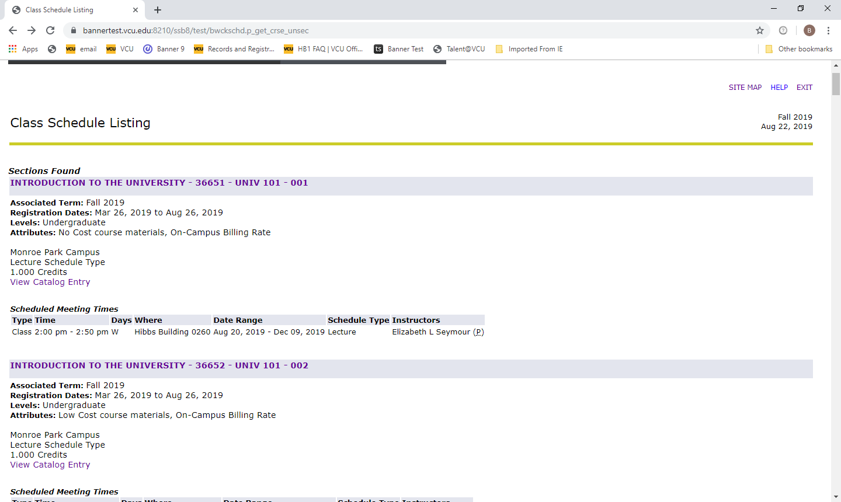

Slide 18
